Slide 1

ES LG.com Monitoring Dashboard
[User Manual]
Concentrix Korea | ‘26.04

Slide 2
Index
1. Common Guide
2. Page Guide
3. Data Guide
1.1 Overview
1.2 Access
1.3 Sitemap
1.4 Monitoring Item
1.5 FAQ
2.1 Interface & Navigation
2.2 View Selection
2.3 Data Export
3.1 Metrics Definition
3.2 Calculation Logic
3.3 Interpreting Status Indicators

Slide 3

1. Common Guide > 1.1 Overview
Purpose
This dashboard is designed to help subsidiaries systematically manage content quality and SEO of AEM pages and LG.com(only B2B) Please refer to the following guide for the specific goal of each monitoring item.
(pages before going live on LG.com)
Monitoring Goals
B2C
Improve the quality of PDP of RAC(all countries), Aircare(HongKong, Malaysia, Singapore, Taiwan, Vietnam, Thailand)
① Content : Enhance PDP content quality and ensure proper content structure
② SEO : Improve search visibility and expand SEO coverage
Expand and improve the SEO area with a focus on Blog and New Contents of SAC(all countries)
① SEO : Improve search visibility and expand SEO coverage (based on AEM & LG.com)
② Content : Ensure Blog contents are updated frequently and CAT/PLP pages are kept up to date (based on LG.com)
③ GNB Structure : Ensure proper navigation between B2B and B2C pages (based on LG.com)
(based on AEM)
B2B
(based on AEM
& LG.com)
Update Frequency
This dashboard is updated on a bi-weekly basis.
①
*Please refer to the ①‘last updated' timestamp in the top-right corner for the latest update date.

Slide 4
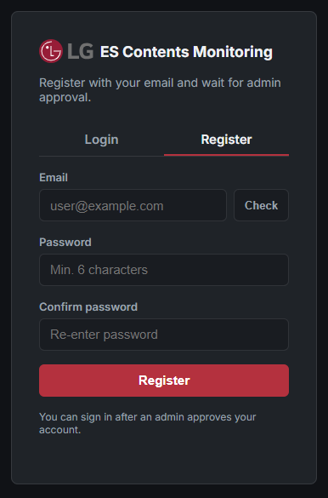
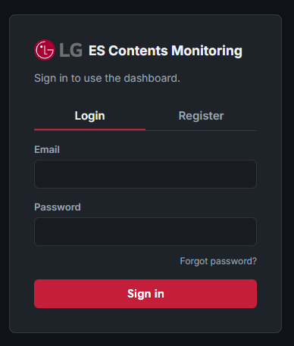
1. Common Guide > 1.2 Access
Only authorized users can access and use dashboards
Access Details
① Register
Users must create valid account through the Register tab.
Click the “Register” tab on the login page.
Enter your email address(ID) and password.
Password must contain at least 6 characters.
Submit the registration request.
After Registration, admin approves the account for activation.
You can sign in only after admin approval.
② Login
- Log in using registered email and password.
- If login fails, check account permission.
①
②

Slide 5
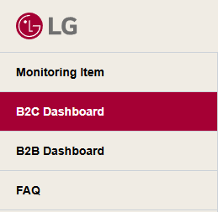
1. Common Guide > 1.3 Sitemap
Monitoring Item
B2C
B2B
B2C Dashboard
Summary
Score by Criteria
Feature Card
B2B Dashboard
Summary
Score by Criteria
GNB Structure
Blog
New Contents
Feature Card
FAQ
Notice
Q&A
FAQ

Slide 6
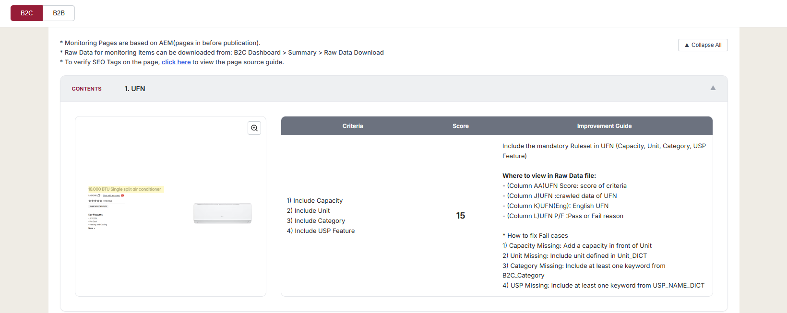
1. Common Guide > 1.4 Monitoring Item
Guide to the monitoring criteria for both B2C and B2B.
Details
① B2C/B2B Tab
Select the specific Business Unit tab to review.
B2C: PDP 3 contents and 4 SEO tags.
B2B: CAT/PLP 5 SEO tags, blog and lg.com uploads, and GNB structure
② Toggle
Collapse All / View All: Use these buttons to manage the visibility of all monitoring items at once.
Custom View: Click individual items to expand or collapse specific details as needed.
③ Monitoring Content & Guidelines
Visual Reference (Left) : Screenshot of the monitoring area; click to enlarge for a detailed view.
Monitoring Details (Right)
  Criteria: Standards that each element must satisfy
  Score: Score for each monitoring item
  Improvement Guide: Instructions on how to fix ‘Fail’ cases and specific data columns in the Raw Data file.
①
②
③

Slide 7
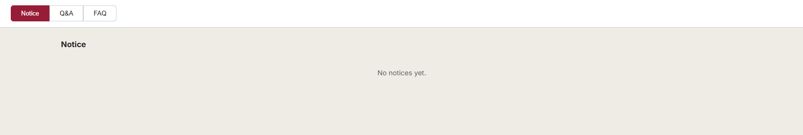
1. Common Guide > 1.5 FAQ
Notice
Details
① Notice
Announcements of updates of logic modifications, etc.

Slide 8
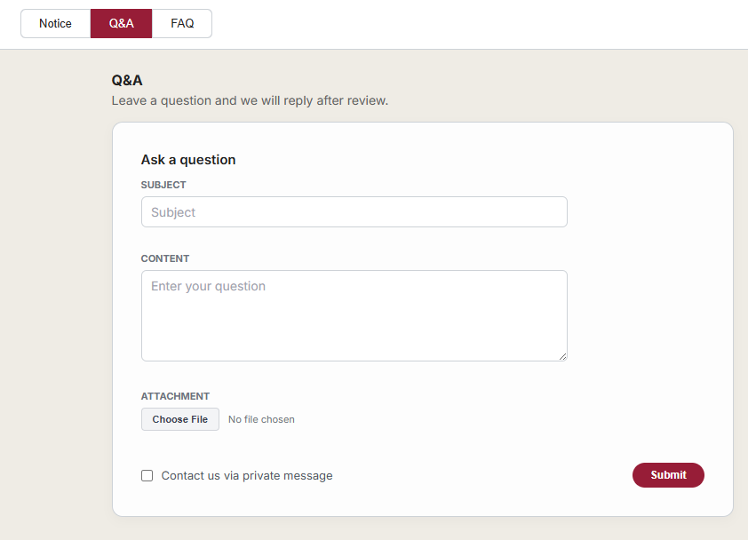
1. Common Guide > 1.5 FAQ
Q&A
Details
② Q&A
Requesting 1:1 Inquiry via Q&A
Subject(mandatory): Enter title
Content(mandatory): Provide detailed information regarding your request
Attachment(Optional): Upload supporting documents or images (Click ‘Choose File’ to upload).
Private Option(Optional): By selecting the ‘Secret’ checkbox, the message will be restricted to the author and the administrator only.
Q&A Status
Drafting: Complete the required fields and attach files if necessary.
Submission: Click the [Submit] button to send your inquiry to the Admin.
Review & Reply: The administrator will review the submission and provide a reply.

Slide 9
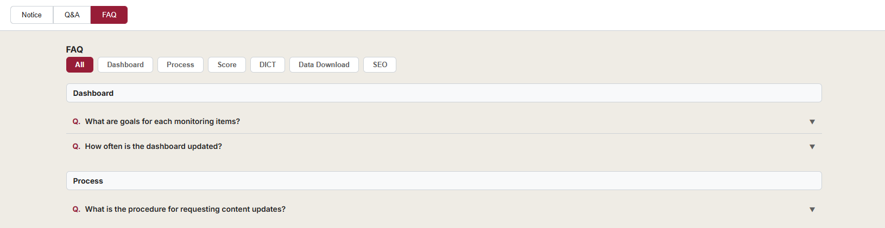
1. Common Guide > 1.5 FAQ
FAQ
Details
③ FAQ
Quick answers to common inquiries.
Category Tabs: Click the tabs at the top of the FAQ list to view questions related to that category.
Toggle View: Clicking on a question reveals its detailed answer instantly

Slide 10
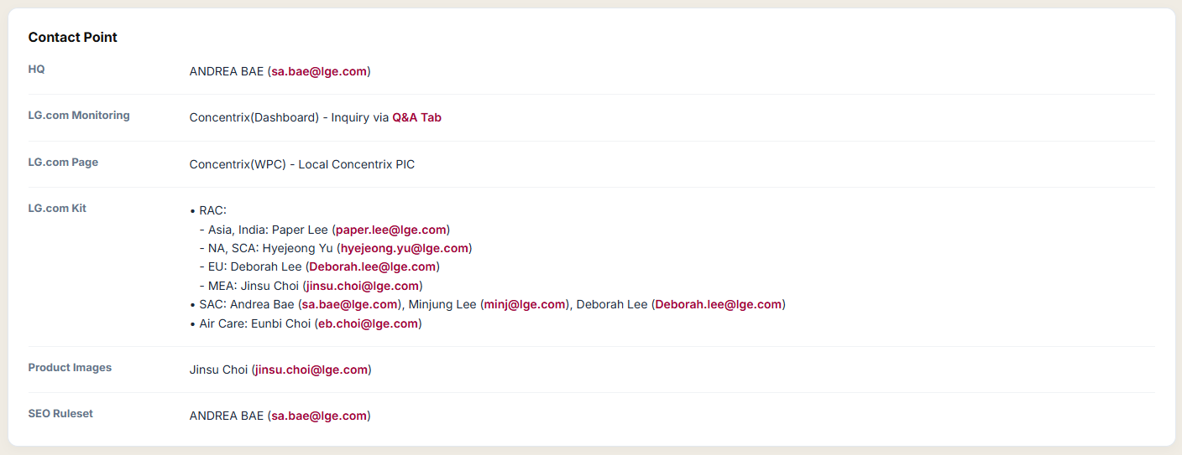
1. Common Guide > 1.5 FAQ
Contact Point
Details
④ Contact Point
Support channels for further assistance located below the FAQ Tab

Slide 11

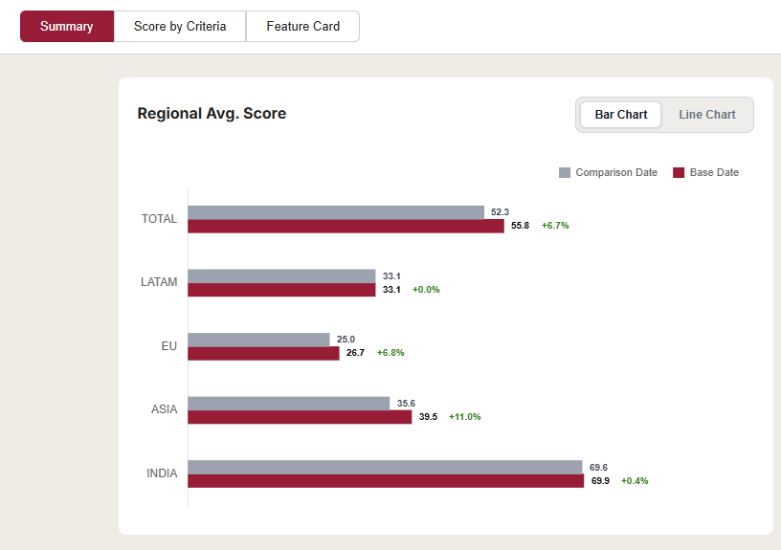
2. Page Guide > 2.1 Interface & Navigation
Control panel
Details
①
②
① Navigation Tabs
Click each tab to navigate through different performance views.
② Date Selection
Base Date: The primary reference month, reflecting the most recent data updates with that period.
Comparison Date: The reference month used for variance analysis, reflecting the final data state of that period.
(Selecting a Comparison Date earlier than the Base Date is recommended for meaningful comparison.)
③ Bar Chart / Line Chart
Bar Chart: Regional Avg. Score Comparison by Period
Line Chart: Monthly Regional Score Trends
③

Slide 12
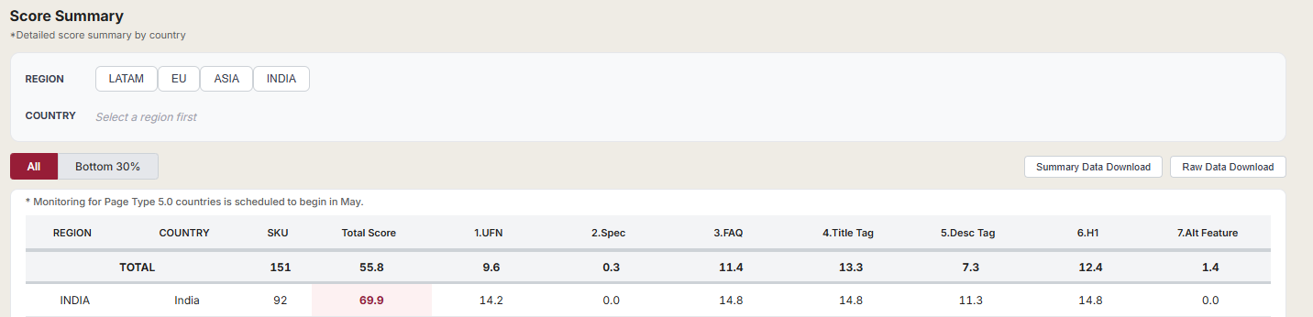

2. Page Guide > 2.2 View Selection
Filtering mechanisms
Details
① Filter (REGION/COUNTRY)
REGION: Users must select a REGION first to activate and filter the corresponding country list.
COUNTRY: Enables localized performance tracking within the selected region.
② View Filters
Switch between different filtering options to focus on specific groups of countries.
All: Display data for all countries within the selected region/country
Bottom 30%: Automatically filters countries with scores of the lowest 30%
  B2C: Based on the total number of monitoring countries(‘All’)
  B2B: Based on the count of ‘Main Countries’
①
② (▲ B2C ▼ B2B)
Countries with Blog pages

Slide 13
2. Page Guide > 2.3 Data Export
Download
Details
① Download
Click the specific download button to export the data.
- Summary Data Download: Aggregated dashboard data exporting the current screen view.
Raw Data Download: Original source-level dataset provided in Excel format.
Datasets are provided and can be downloaded in each monitoring category tab.
①

Slide 14
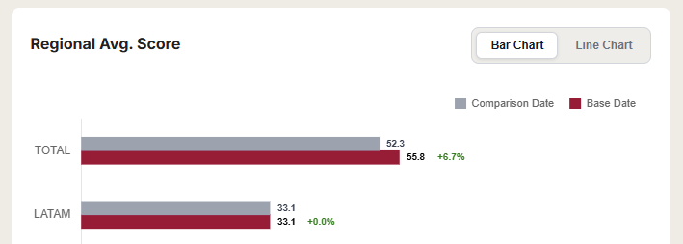
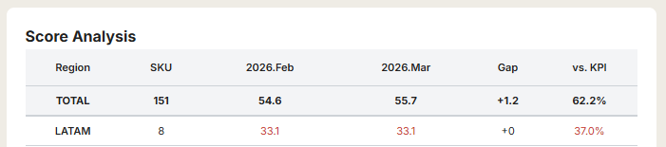
3. Page Guide > 3.1 Metrics Definitions
Definitions of indicators used throughout this dashboard
Details
Summary
① Regional Avg. Score
The total score for each specific region based on the Base Date and Comparison Date.
Growth Rate (Green): MoM change in total score between the base date and comparison date.
② SKU: The total number of unique monitoring pages for each specific region based on the Base Date
③ Regional Total Score by Date: The average score of the region for each specific period (Comparison vs. Base).
④ Gap: The gap between the Base Date and the Comparison Date score.
⑤ vs. KPI: Achievement rate of the Base Date score compared to the target KPI.
B2C KPI Target: 90
B2B KPI Target: 96
①
②
③
④
⑤

Slide 15
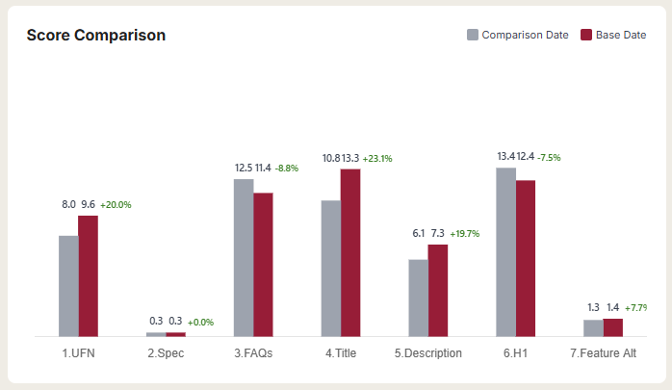
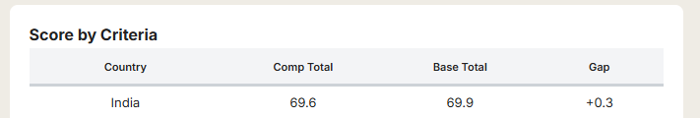
3. Page Guide > 3.1 Metrics Definitions
Definitions of indicators used throughout this dashboard
Details
Score by Criteria
① Average Score by Monitoring Item
The average score by each monitoring item based on the selected region or country.
Default View: If no filters are selected, the chart shows the Total average by default.
Growth Rate (Green): MoM change in total score between the base date and comparison date.
② Regional Total Score by Date: The total score for specific country across two selected periods (Comparison vs. Base).
③ Gap: The gap between the Base Total and Comp Total.
①
②
③

Slide 16
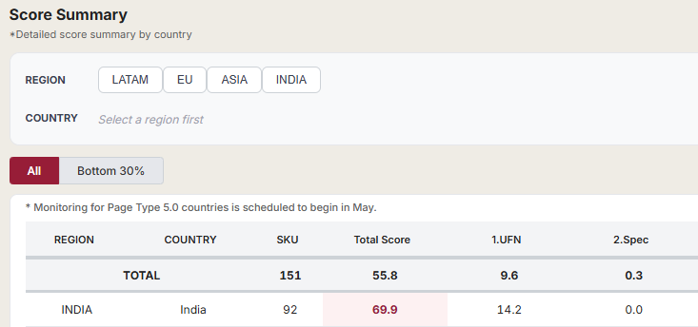
3. Page Guide > 3.2 Calculation Logic
Calculation logic for major metrics
Details
Summary – Score Summary
① SKU: The total number of unique monitoring pages of the Base Date.
② Total Score: Sum of all monitoring items score
③ Item Score: Average score of a specific monitoring item
①
②
③

Slide 17
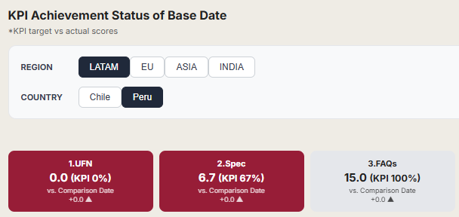



3. Page Guide > 3.2 Calculation Logic
Calculation logic for major metrics
Details
Score by Criteria – KPI Achievement Status of Base Date
① KPI Status Indicators
Red Card: Score fails to meet the KPI target.
Grey Card: KPI is achieved.
② Item Score
= Average score of a specific monitoring item
③ KPI Achievement Rate (%)
= $\frac{(Base Date Score)}{(KPI Target Score)}$ × 100
KPI Target Score
- B2C: Max Item Score × 90%
- B2B: Max Item Score × 96%
④ Gap (Comparison vs. Base)
- Gap between the Base Date score and the Comparison Date Score.
- ‘+’ indicates score improvement and ‘-’ indicates score decline.
①
②
③
④

Slide 18
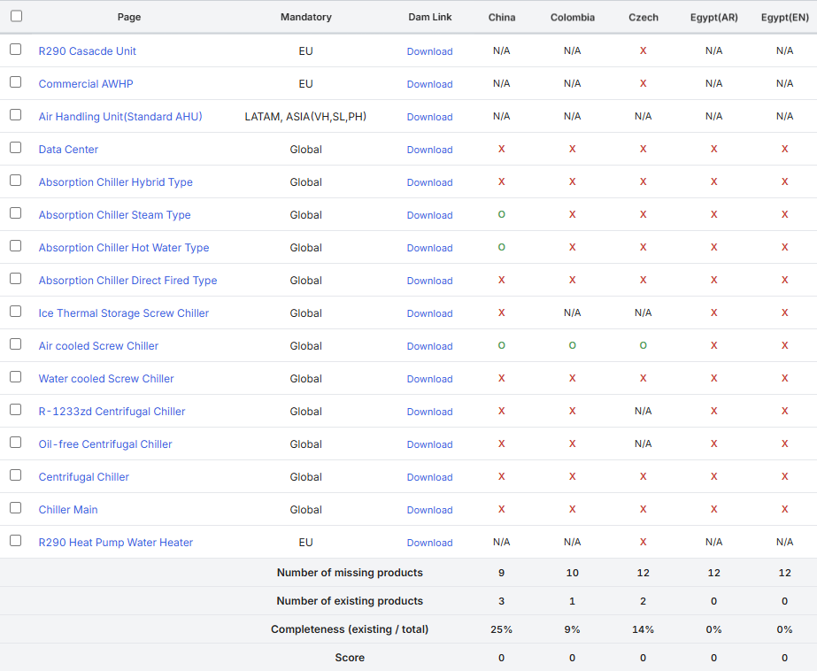

3. Page Guide > 3.2 Calculation Logic
Calculation logic for major metrics
Details
New Contents – LG.com New Contents
① Number of missing products
= Count of ‘X’
Number of existing products
= Count of ‘O’
Completeness (existing / total) (%)
= $\frac{(Number of existing products)}{(Number of missing products + Number of existing products)}$× 100
Score
15 Points: Achieved when Completeness is 100%
10 Points: Achieved when Completeness is over 90% but under 100%.
0 Points: Assigned if Completeness is below 90%
①

Slide 19
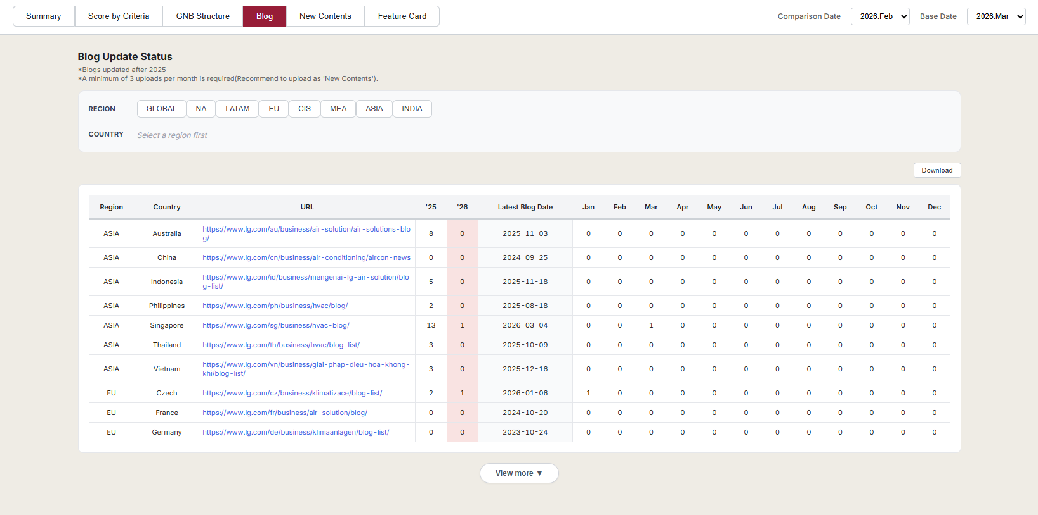
3. Page Guide > 3.3 Interpreting Status Indicators
How to View ‘B2B Dashboard – Blog’ Tab
Details
Blog Update Status
① Yearly Blog Count (‘25, ’26)
The total number of blog posts published in year.
② Latest Blog Date
The upload date of the most recent post.
③ Monthly Update Status (Jan ~ Dec 2026)
Number of monthly blog posts published in 2026.
①
②
③

Slide 20
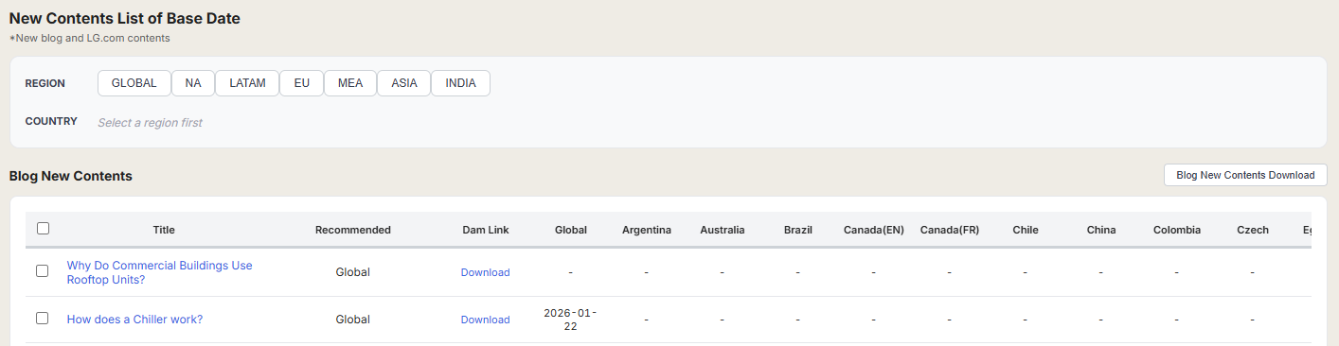
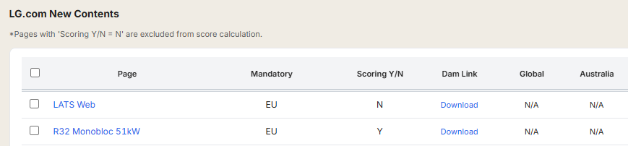
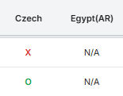
3. Page Guide > 3.3 Interpreting Status Indicators
How to View ‘B2B Dashboard – New Contents’ Tab
Details
New Contents List of Base Date
① Title or Page: Content Title
- Click to view reference of the page on the Global site.
② Recommended or Mandatory: Content Requirement
- Recommended (Blog): Content that is suggested for the region
- Mandatory (LG.com): Countries mentioned as mandatory are designated for uploading the page.
③ Scoring Y/N (Only for LG.com New Contents)
- Pages with ‘Scoring Y/N = N’ are excluded from score calculation.
④ Dam Link
- Click the [Download] button to access to DAM link for assets.
⑤ Blog New Contents (Upload Status)
Date: Displays the ‘Upload Date’ if the post is uploaded.
‘-’ (Hyphen): Indicates that the content has not yet been uploaded.
⑥ LG.com New Contents (Upload Status)
‘O’: Content is successfully uploaded.
‘X’: Content is missing/not yet uploaded.
‘N/A’: The content is not applicable for monitoring in the specific country.
①
②
④
⑤
③
⑥

Slide 21
End of Document

